Slide 1

Database Systems: Design, Implementation, and Management Ninth Edition
Chapter 1
Database Systems

Slide 2
Learning outcomes
In this chapter, you will learn:
The difference between data and information
What a database is, the various types of databases, and why they are valuable assets for decision making
The importance of database design
How modern databases evolved from file systems

Slide 3
Learning outcomes (cont’d.)
About flaws in file system data management
The main components of the database system
The main functions of a database management system (DBMS)

Slide 4
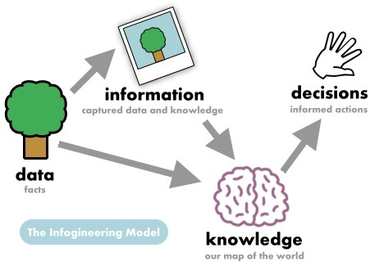
Introduction
Good decisions require good information derived from raw facts/data
Data is managed most efficiently when stored in a database
Databases evolved from computer file systems
Understanding file system characteristics is important

Slide 5
Why Databases?
Databases solve many of the problems encountered in data management
Used in almost all modern settings involving data management:
Business
Research
Administration
Important to understand how databases work and interact with other applications

Slide 6
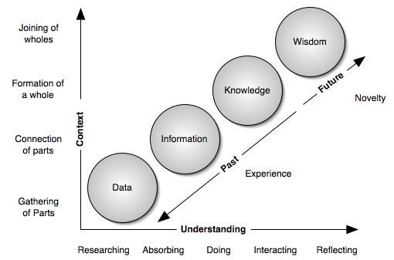
Data vs. Information

Slide 7
Data vs. Information
Data are raw facts
Information is the result of processing raw data to reveal meaning
Information requires context to reveal meaning
Raw data must be formatted for storage, processing, and presentation
Data are the foundation of information, which is the bedrock of knowledge

Slide 8
Data vs. Information (cont’d.)
Data: building blocks of information
Information produced by processing data
Information used to reveal meaning in data
Accurate, relevant, timely information is the key to good decision making
Good decision making is the key to organizational survival

Slide 9


Data vs. Information (cont’d.)
Example
the photograph is information. But, what you look like is data
Source: http://www.infogineering.net/data-information-knowledge.htm

Slide 10
Data vs. Information (cont’d.)
Example
Data:
You are 5 feet tall
You have brown hair
You have blue eyes
Etc….
Information
You’ve gathered all the data. Next you describe that photograph to other people. It becomes information. Why? You have shared with other people.

Slide 11
Introducing the Database
Database: shared & integrated computer structure that stores a collection of:
End-user data: raw facts of interest to end user
[1] provided by a data warehouse or the data [2] created by end users for query processing.
Metadata: data about data
Provides description of data characteristics and relationships in data, OR
Provides information about a certain item's content
Complements and expands value of data

Slide 12
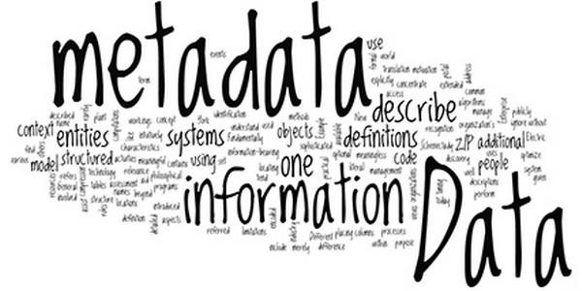
Introducing the Database
More on Metadata
an image may include metadata that describes how large the picture is, the color depth, the image resolution, when the image was created, and other data
A text document's metadata may contain information about how long the document is, who the author is, when the document was written, and a short summary of the document

Slide 13
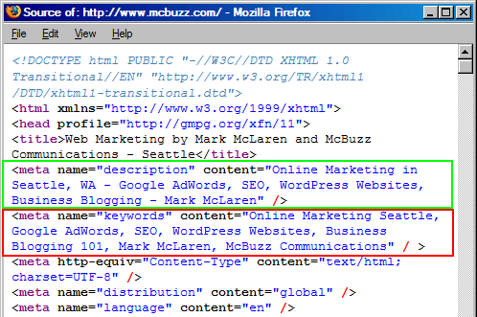
Introducing the Database
More on Metadata
Web pages often include metadata in the form of meta tags. Description and keywords meta tags are commonly used to describe the Web page's content. Most search engines use this data when adding pages to their search index

Slide 14
Role and Advantages of the DBMS
Database management system (DBMS): collection of programs
Manages structure and controls access to data
DBMS is the intermediary between the user and the database
Database structure stored as file collection
Can only access files through the DBMS
DBMS enables data to be shared
DBMS integrates many users’ views of the data

Slide 15
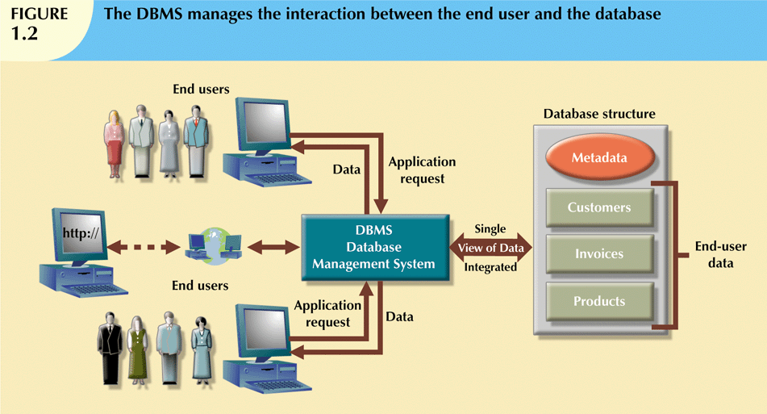

Slide 16
Role and Advantages of the DBMS (cont’d.)
Advantages of a DBMS:
Improved data sharing
Improved data security
Better data integration
Minimized data inconsistency
Improved data access
Improved decision making
Increased end-user productivity

Slide 17
Types of Databases
Databases can be classified according to:
DB classification
[1] Users
[2] Location
[3] Usage
Single-User
Centralized
Operational
Multiuser
Distributed/
Decentralized
Warehouse

Slide 18
Types of Databases
[1] Users
Single-user database supports only one user at a time
Desktop database: single-user; runs on PC (locally)
E.g. Auto Teller Machine (ATM)
Multiuser database supports multiple users at the same time
Workgroup and enterprise databases
E.g. i-Student Portal, any Web application

Slide 19
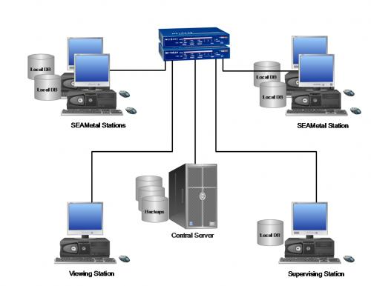
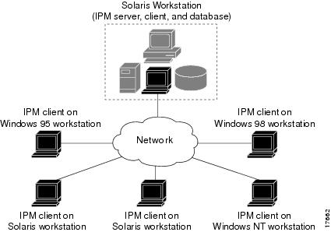
Types of Databases (cont’d.)
[2] Location
Centralized database: data located at a single site
Distributed/Decentralized database: data distributed across several different sites

Slide 20
Types of Databases (cont’d.)
[3] Usage
Operational database: supports a company’s day-to-day operations
Transactional or production database
Data warehouse: stores data used for tactical or strategic decisions
Meant for top management for decision making, forecasting, strategic planning

Slide 21
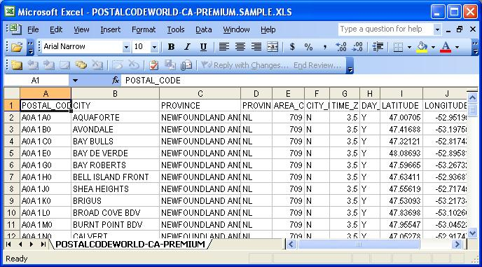
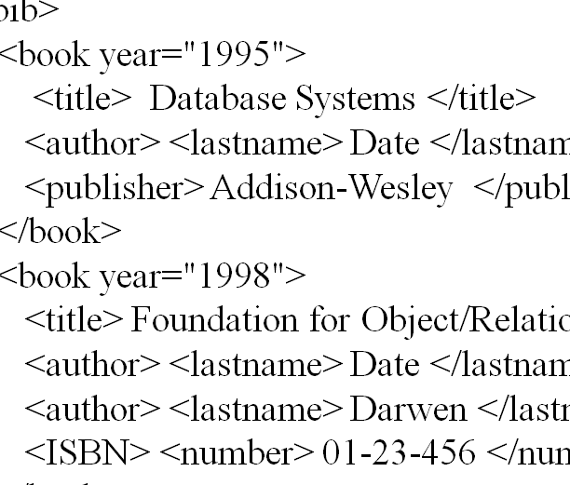

Types of Databases (cont'd.)
Categories of data
Structured data
data that is identifiable because it is organized in a structure
e.g. database
Semi-structured data
Has structure but not enough to qualify as structured data (Loshin, 2005)
e.g. XML
Unstructured data
No identifiable structure/in original format
e.g. bitmap images/objects, text and other data types that are not part of a database

Slide 22
Types of Databases (cont'd.)
Unstructured data exist in their original state
Structured data result from formatting
Structure applied based on type of processing to be performed
Semi structured data have been processed to some extent
Data may have certain structure but not all information collected has identical structure
Some attributes may exist in some of the entities of a particular type but not in others
Extensible Markup Language (XML) represents data elements in textual format
XML database supports semistructured XML data

Slide 23
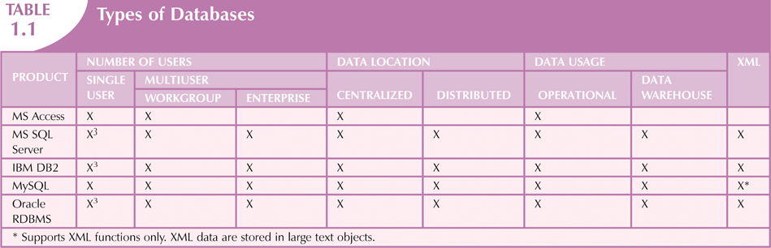

Slide 24

Why Database Design Is Important
Database design focuses on design of database structure used for end-user data (= what?)
Designer must identify database’s expected use
Well-designed database:
Facilitates data management
Generates accurate and valuable information
Poorly designed database:
Causes difficult-to-trace errors

Slide 25
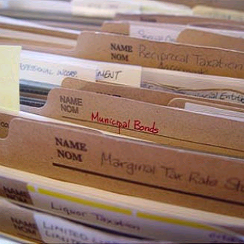
Evolution of File System Data Processing
Reasons for studying file systems/filesystems:
Complexity of database design is easier to understand
Understanding file system problems helps to avoid problems with DBMS systems
Knowledge of file system is useful for converting file system to database system
File systems typically composed of collection of file folders, each tagged and kept in cabinet
Organized by expected use

Slide 26

Evolution of File System Data Processing
Manual File Systems
Computer File Systems
Database
IBM DB2/
DBMS
MS EXCEL

Slide 27
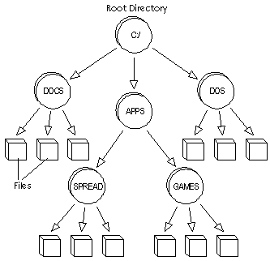

Evolution of File System Data Processing
Physical
Conceptual/logical

Slide 28
Evolution of File System Data Processing (cont'd.)
Contents of each file folder are logically related
Manual systems (current file systems)
Served as a data repository for small data collections
Cumbersome for large collections
Computerized file systems
Data processing (DP) specialist (special position) converted computer file structure from manual system
Wrote software that managed the data
Designed the application programs to generate reports

Slide 29
Evolution of File System Data Processing (cont'd.)
Initially, computer file systems resembled manual systems
As number of files increased, file systems evolved
Each file used its own application program to store, retrieve, and modify data
Each file was owned by individual or department that commissioned its creation

Slide 30
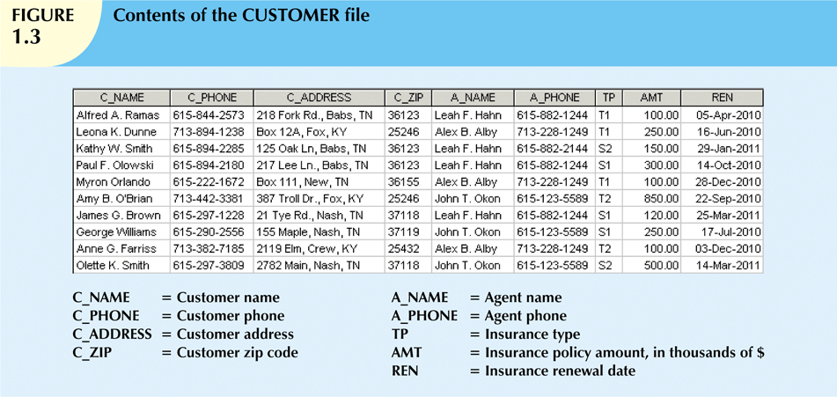
Typical computer file systems

Slide 31
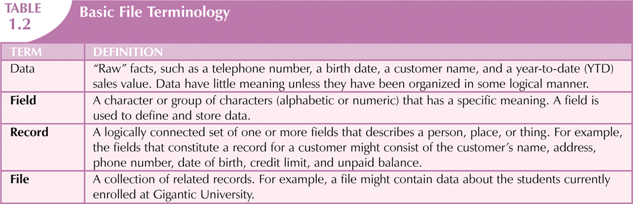

Slide 32
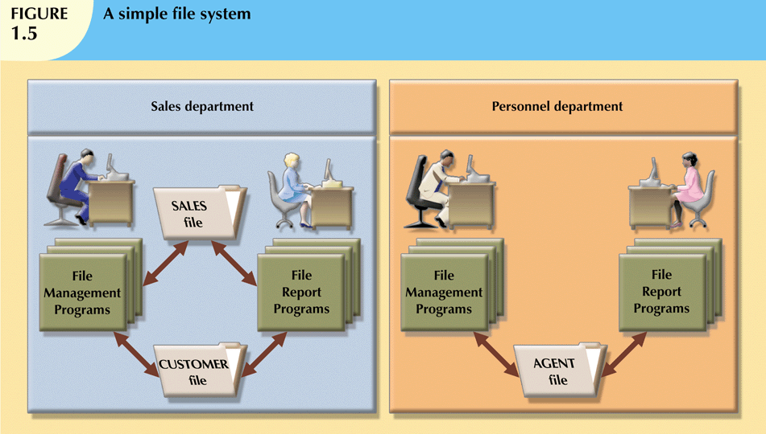

Slide 33
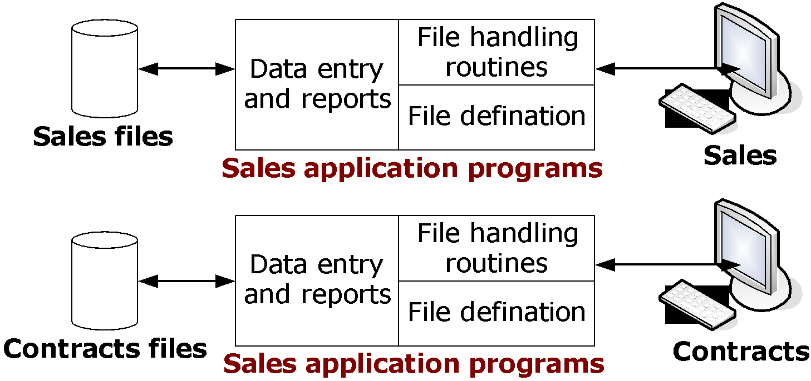
Another example:
Sales application programs
Contracts application programs

Slide 34
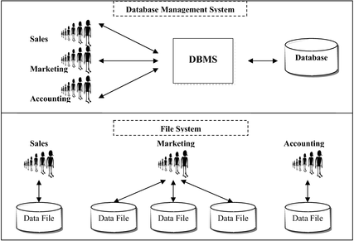

Slide 35
Problems with File System Data Processing
File systems were an improvement over manual system
File systems used for more than two decades
Understanding the shortcomings of file systems aids in development of modern databases
Many problems not unique to file systems
Even simple file system retrieval task required extensive programming
Ad hoc queries impossible
Changing existing structure difficult

Slide 36
Problems with File System Data Processing (cont'd.)
Security features difficult to program
Often omitted in file system environments
Summary of file system limitations:
Requires extensive programming
Cannot perform ad hoc queries
System administration is complex and difficult
Difficult to make changes to existing structures
Security features are likely to be inadequate

Slide 37
Structural and Data Dependence
Structural dependence: changes in the database structure affect DBMS ability to access data.
All file system programs must be modified to conform to a new file structure
E.g. filesystems, adding new field/attribute
Structural independence: changes in the database structure DO NOT affect DBMS ability to access data.

Slide 38
Structural and Data Dependence (cont'd.)
Customer
Structural Dependent
An attribute Customer_email has been added to Customer file. Therefore, you have to modify your data retrieval program.
Customer_no
Customer_name
Customer_phone
Customer_address
Customer
Customer_no
Customer_name
Customer_phone
Customer_address
Customer_email
New!

Slide 39
Structural and Data Dependence (cont'd.)
Data dependence: data access changes when data storage characteristics change
Data is represented/embedded in the source code for the programs
Data independence: changes on data storage characteristics do not affect data access
Data and programs are separated

Slide 40
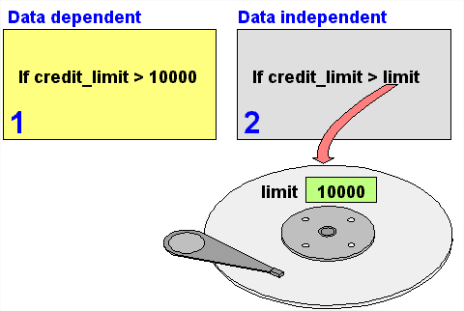
Structural and Data Dependence (cont'd.)
Data independent
It allows the database to be structurally changed without affecting most existing programs.
In this case, we can assign value of limit dynamically (user input).

Slide 41
Structural and Data Dependence (cont'd.)
You have this…
float salary = 5000, allowances = 1100;
float totalsalary = 0;
totalsalary = salary + allowances;
Now, make it dynamic. So, user can enter any values for salary and allowances. How?
cout<<"Enter your salary: RM";
cin>>salary;
cout<<"Enter your allowances: RM";
cin>>allowances;

Slide 42
Structural and Data Dependence (cont'd.)
Practical significance of data dependence is difference between logical and physical format
Logical data format: how human views the data
Physical data format: how computer must work with data
Each program must contain:
Lines specifying opening of specific file type
Record specification
Field definitions

Slide 43
Data Redundancy
File system structure makes it difficult to combine data from multiple sources
Vulnerable to security breaches
Organizational structure promotes storage of same data in different locations
Islands of information
Similar Data stored in different locations is unlikely to be updated consistently
Data redundancy: same data stored unnecessarily in different places/tables/entities

Slide 44
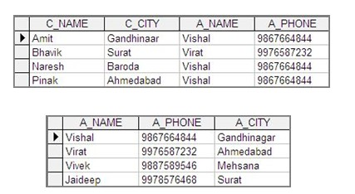
Data Redundancy (cont'd.)
Data inconsistency: different and conflicting versions of same data occur at different places
Table: Customer
Table: Agent

Slide 45
Data Redundancy (cont'd.)
Data anomalies: abnormalities when all changes in redundant data are not made correctly
Update anomalies:
E.g. what if client changes his phone number?
Insertion anomalies:
E.g. to add new property without adding its owner
Deletion anomalies:
E.g. what if client’s record is to be removed from the system?

Slide 46
Data Redundancy (cont'd.)
Refer to Slide 43 (slide 37 for old version)
Update anomaly. If agent Vishal has a new phone number, that number must be entered in each of the CUSTOMER file records. In this case, only three changes must be made. In a large file system, such changes might occur in hundreds or even thousands of records.
Insertion anomaly. If only the CUSTOMER file exists, to add a new agent, you would also add a dummy customer data entry to reflect the new agent’s addition.
Deletion anomaly. If you delete the customers Amit, Naresh and Bhavik, you will also delete Vishal’s agent data. Clearly this is not desirable.

Slide 47
Lack of Design and Data-Modeling Skills
Most users lack the skill to properly design databases, despite multiple personal productivity tools being available
Data-modeling skills are vital in the data design process
Good data modeling facilitates communication between the designer, user, and the developer

Slide 48
Database Systems
Database system consists of logically related data stored in a single logical data repository
May be physically distributed among multiple storage facilities
DBMS eliminates most of file system’s problems
Current generation stores data structures, relationships between structures, and access paths
Also defines, stores, and manages all access paths and components

Slide 49
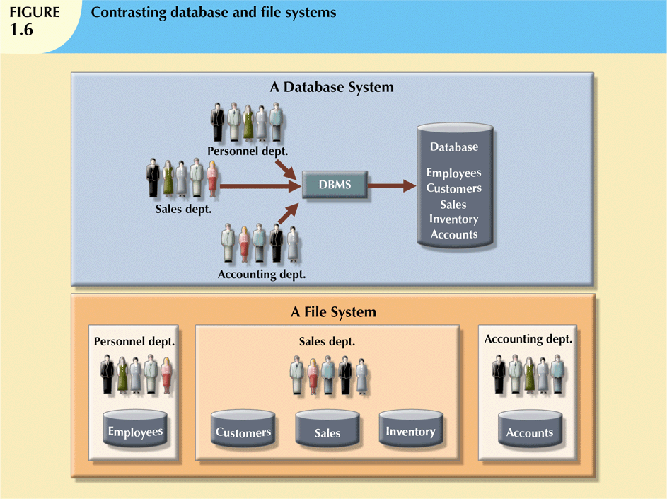

Slide 50
The Database System Environment
Database system: an organization of components that defines and regulates the collection, storage, management, use of data
hardware
software
data
procedure
people
bridge
machine components
human components

Slide 51
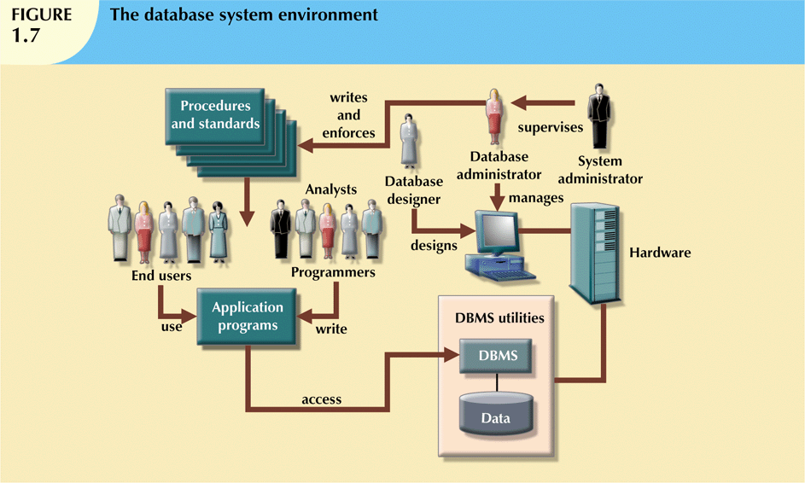

Slide 52
The Database System Environment (cont'd.)
Hardware: all the system’s physical devices
PC, Workstation, Server, Mainframe, Supercomputer
Software: three types of software required:
Operating system software
DBMS software: IBM DB2, Oracle, MySQL, etc
Application programs and utility software

Slide 53
The Database System Environment (cont'd.)
Data: the collection of facts stored in the database
People: all users of the database system
System and database administrators
Database designers
Systems analysts and programmers
End users
Procedures: instructions and rules that govern the design and use of the database system

Slide 54
The Database System Environment (cont'd.)
Database systems are created and managed at different levels of complexity
Database solutions must be cost-effective as well as tactically and strategically effective
Database technology already in use affects selection of a database system

Slide 55
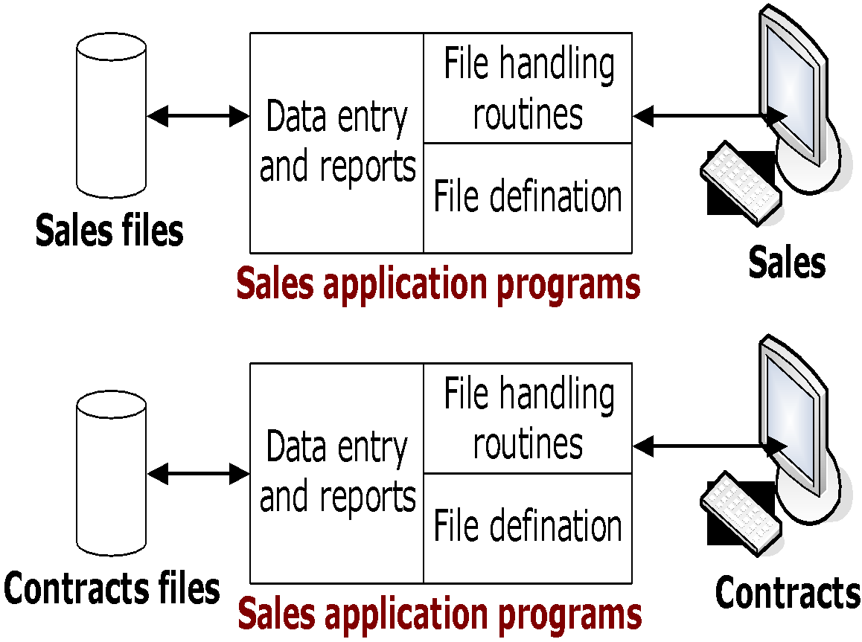
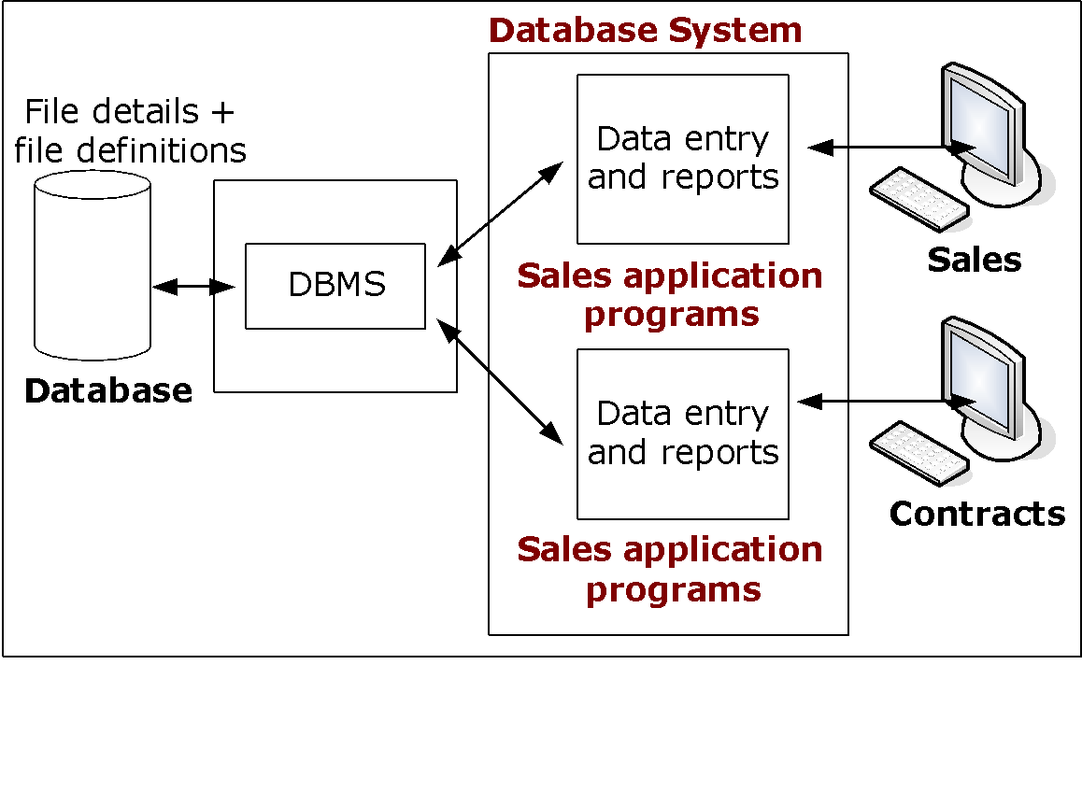
The Database System Environment (cont'd.)
File Systems
DBMS
Sales application
programs
Sales application
programs
Contracts application programs
Contracts application programs

Slide 56
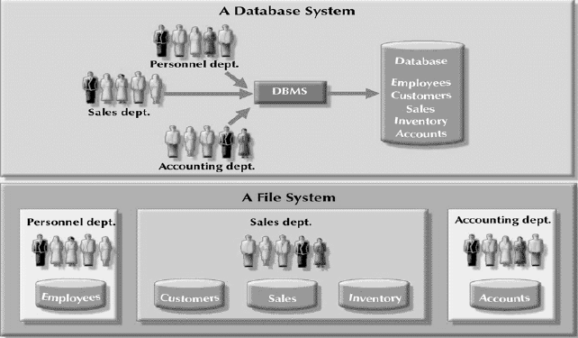
The Database System Environment (cont'd.)

Slide 57
DBMS Functions
Most functions are transparent to end users
Can only be achieved through the DBMS
[1] Data dictionary management
DBMS stores definitions of data elements and relationships (metadata) in a data dictionary
DBMS looks up required data component structures and relationships
Changes automatically recorded in the dictionary
DBMS provides data abstraction and removes structural and data dependency

Slide 58
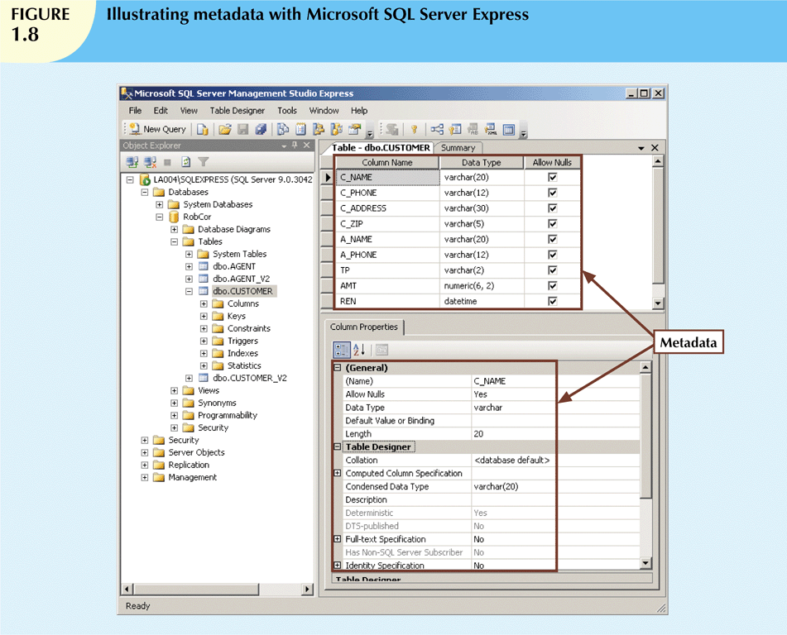

Slide 59
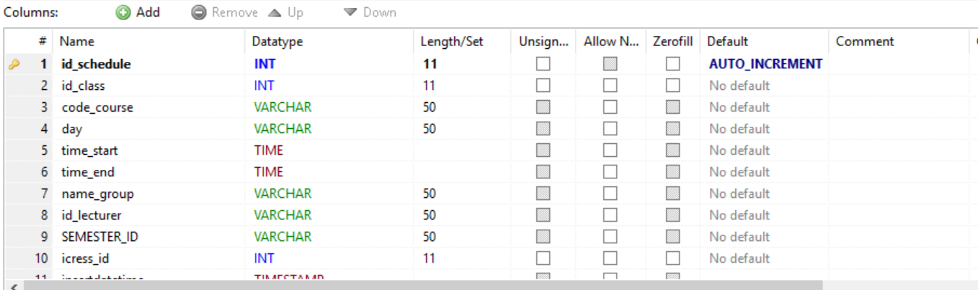

Slide 60
DBMS Functions (cont'd.)
[2] Data storage management
DBMS creates and manages complex structures required for data storage
Also stores related data entry forms, screen definitions, report definitions, etc.
Performance tuning: activities that make the database perform more efficiently
DBMS stores the database in multiple physical data files

Slide 61
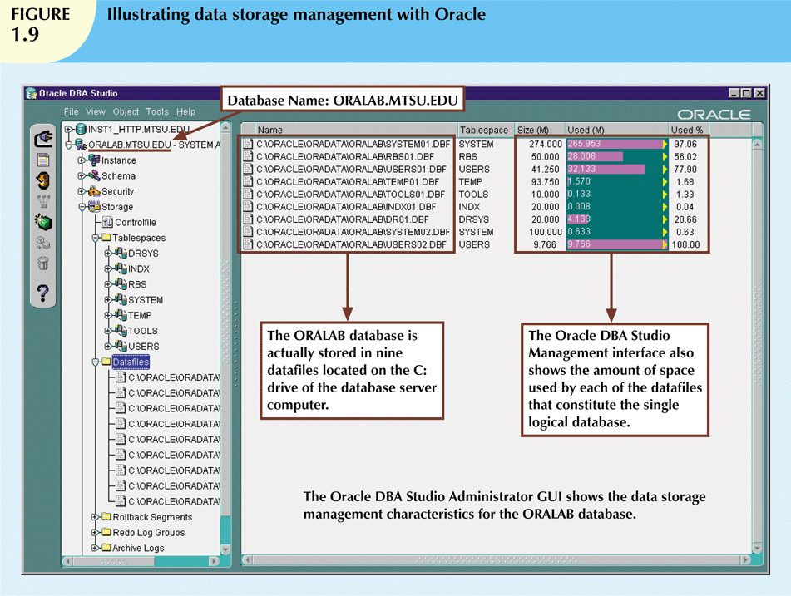

Slide 62
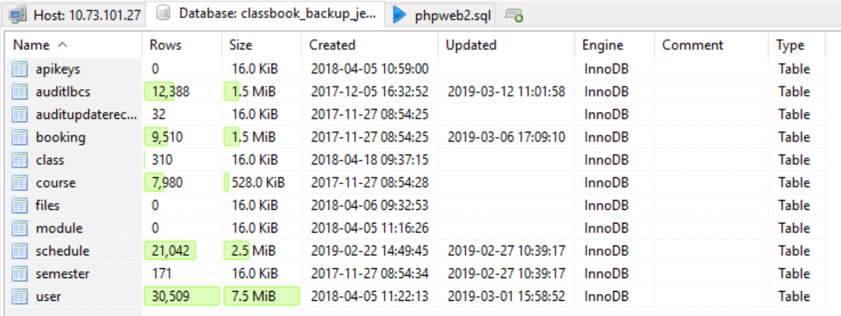

Slide 63
DBMS Functions (cont'd.)
[3] Data transformation and presentation
DBMS transforms data entered to conform to required data structures
DBMS transforms physically retrieved data to conform to user’s logical expectations
[4] Security management
DBMS creates a security system that enforces user security and data privacy
Security rules determine which users can access the database, which items can be accessed, etc.

Slide 64
DBMS Functions (cont'd.)
[5] Multiuser access control
DBMS uses sophisticated algorithms to ensure concurrent access does not affect integrity
[6] Backup and recovery management
DBMS provides backup and data recovery to ensure data safety and integrity
Recovery management deals with recovery of database after a failure
Critical to preserving database’s integrity

Slide 65
DBMS Functions (cont'd.)
[7] Data integrity management
DBMS promotes and enforces integrity rules
Minimizes redundancy
Maximizes consistency
Data relationships stored in data dictionary used to enforce data integrity
Integrity is especially important in transaction-oriented database systems
CASCADE & FOREIGN KEY commands

Slide 66
DBMS Functions (cont'd.)
[8] Database access languages and application programming interfaces
DBMS provides access through a query language
Query language is a nonprocedural language
Structured Query Language (SQL) is the de facto query language
Standard supported by majority of DBMS vendors

Slide 67
DBMS Functions (cont'd.)
[9] Database communication interfaces
Current DBMSs accept end-user requests via multiple different network environments
Communications accomplished in several ways:
End users generate answers to queries by filling in screen forms through Web browser
DBMS automatically publishes predefined reports on a Web site
DBMS connects to third-party systems to distribute information via e-mail

Slide 68
Managing the Database System: A Shift in Focus
Database system provides a framework in which strict procedures and standards enforced
Role of human changes from programming to managing organization’s resources
Database system enables more sophisticated use of the data
Data structures created within the database and their relationships determine effectiveness

Slide 69
Managing the Database System: A Shift in Focus (cont'd.)
Disadvantages of database systems:
Increased costs: hardware, software
Management complexity: data safety, data security, manage resistance, company’s goals, etc
Maintaining currency: keep your system up-to-date
Vendor dependence
Frequent upgrade/replacement cycles: upgrading cost, training, compatibility issues,

Slide 70
Summary
Data are raw facts
Information is the result of processing data to reveal its meaning
Accurate, relevant, and timely information is the key to good decision making
Data are usually stored in a database
DBMS implements a database and manages its contents

Slide 71
Summary (cont'd.)
Metadata is data about data
Database design defines the database structure
Well-designed database facilitates data management and generates valuable information
Poorly designed database leads to bad decision making and organizational failure
Databases evolved from manual and computerized file systems

Slide 72
Summary (cont'd.)
In a file system, data stored in independent files
Each requires its own management program
Some limitations of file system data management:
Requires extensive programming
System administration is complex and difficult
Changing existing structures is difficult
Security features are likely inadequate
Independent files tend to contain redundant data
Structural and data dependency problems

Slide 73
Summary (cont'd.)
Database management systems were developed to address file system’s inherent weaknesses
DBMS present database to end user as single repository
Promotes data sharing
Eliminates islands of information
DBMS enforces data integrity, eliminates redundancy, and promotes security

Slide 74

Simple Case Study

Slide 75
ITS232 Projects
[1] Flight Reservation Management Database
[2] Library Management Database – Book Reservation
[3] Food Ordering Database for Restaurant
[4] Hotel Reservation Management Database
[5] Cinema Ticketing Database
[6] Futsal Court Reservation Database
[7] Complaint Database

